Slide 1
Covid-19 Cases in Kenya by County
Charles Ivia
July 2021

Slide 2
Case Study Overview
Objective
The tasks
Tools used
Visualize Covid-19 cases in Kenya by county.
- Identify credible source of data on Covid-19 county level statistics i.e cases, deaths e.t.c
- Extract data and store it in a CSV file.
- Create compelling visualizations on key findings and trends.
- Python for computations, data cleaning and analysis
- Google sheets for data collection and storage
- Tableau for visualizations

Slide 3
What is the problem I’m trying to solve? What data is needed? Where is it?
Check data for errors and clean it. Document the cleaning process.
Determine the best way to share my findings and create effective data vizzes.
ASK
PREPARE
PROCESS
ANALYZE
SHARE
Ensure the data is Reliable, Original, Current, Comprehensive and cited.
What are the trends and relationships in the data?
Notes:
ROCCC stands for Reliable, Original, Comprehensive, Current and Cited

Slide 4
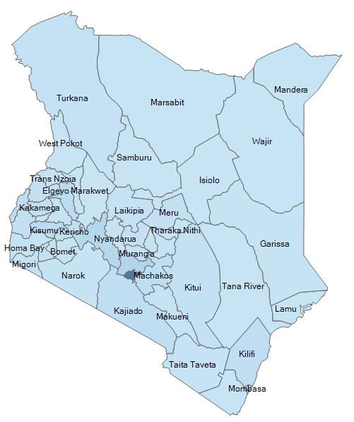
Distribution of Covid-19 cases per county
The Capital is the epicenter of Covid-19
As of July 18, 2021 Nairobi registered the most Covid-19 cases in Kenya with 80922 cases.
The total infections in the country is 192669.
Notes:
The darker the blue color, the more the Covid-19 cases.

Slide 5
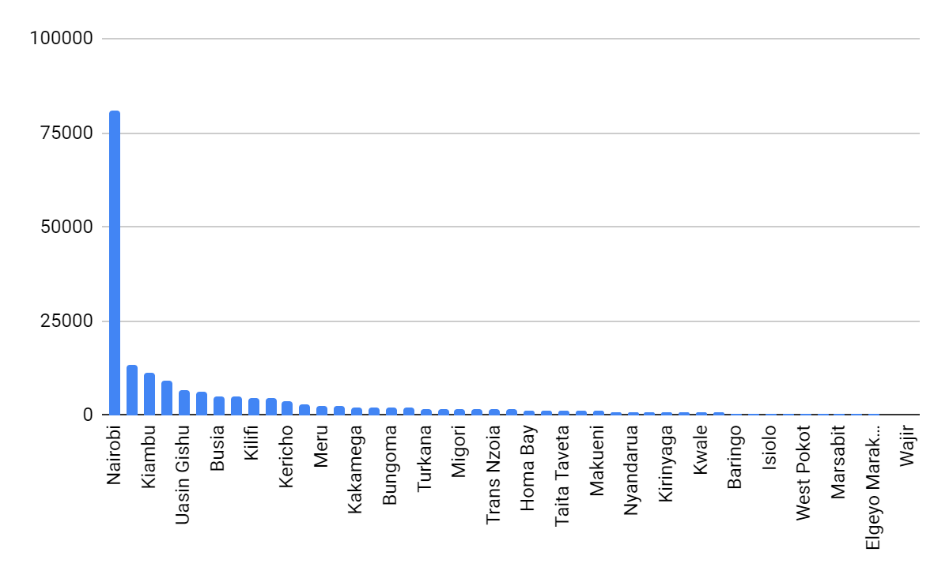
Covid-19 cases per county (highest to lowest)
Nairobi leads, Wajir trails
Nairobi county contributes 42.0% of all covid-19 cases in Kenya.
Top 10 counties with highest infections make up 73.88% of all infections.

Slide 6
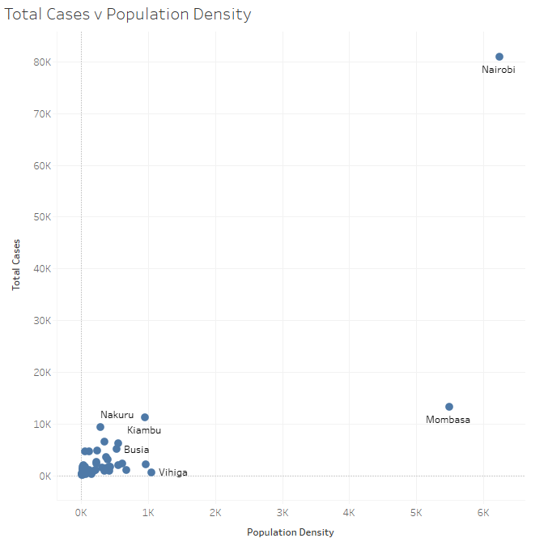
Correlation between cases and pop density
There is a a high positive correlation of 0.8127 between total case per county and population density
Mombasa and Nairobi appear to be outliers. Removing them yields a correlation of 0.4047 indicating medium positive correlation.
Notes:
Pearson correlation coefficient is used.
Correlation does not infer causation. However, given that Covid-19 is highly infectious, this might be the case here. Further research is required.
Also consider that removing Nairobi and Mombasa lowers the correlation greatly.

Slide 7
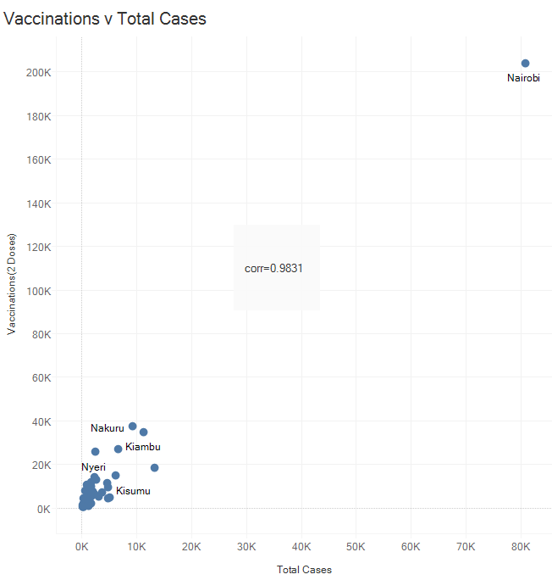
Correlation between cases & vaccinations
There is a high positive correlation of 0.9831 between vaccinations and covid-19 cases per county.
Nairobi appear to be an outlier. Removing it yields
a correlation of 0.7611. Still quite high.
Notes:
The ministry of health has gotten the vaccinations right by ensuring counties with most Covid-19 cases get more vaccinations.
Notice that vaccinations depend on Covid-19 cases and not the other way round.

Slide 8
Challenges deep-dive
Challenge 1
Challenge 2
Challenge 2
Absence of data
Reliable data on Covid-19 deaths, number of tests and recoveries per county was not available.
Low resolution vizzes
Tableau does not support exportation of high resolution visualizations. Thus, I was forced to use lower quality vizzes on my slides.
Notes:
“There are two kinds of data analysts. 1.) Those who can extrapolate from incomplete data.”

Slide 9
Conclusions
The immunization campaign in the Kenya is unbiased.
Further research is needed to establish causation between population density and infections
Further research is needed to identify the effect of vaccinations on Covid-19 cases per county.
Determine if the number of cases per county correlate with number of tests done.

Slide 10
Thank you.

